Slide 1


MACHINE FAILURE PREDICTION
By –Nithesh Ramanna

Slide 2
Business problem
DESCRIPTION
Currently, a car manufacturing company is not using any predictive models to predict the probability of the machine failure and it is fully relied on failure incidents reported by its employees. To avoid interrupts in production line for several hour due to the machine failure it is important for the company to know in advance whether a machine will fail or not.
GOAL OF THE PROJECT
A new predictive model for the company which predicts the machine failure in advance. The model to be more efficient to avoid the production interrupts and the model should be easy to interpret.

Slide 3
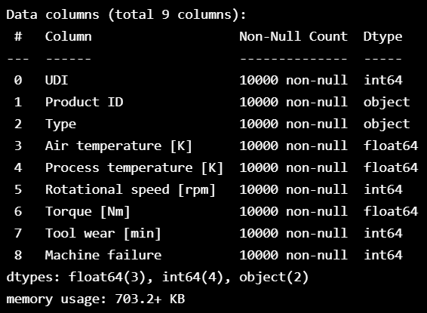
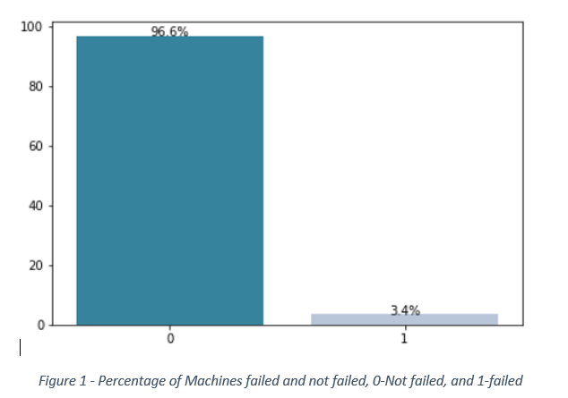
Exploration data analysis
The given dataset has 10000 observations with the details of machines, and it has around 3.4% of machine failure incidents. The given dataset has 9 variables.

Slide 4
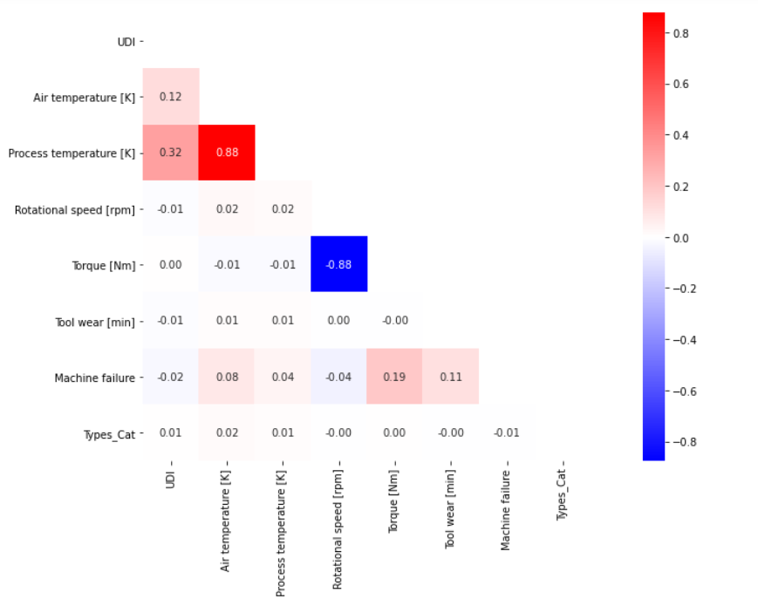
Correlation between variables
Looking at the correlation matrix we can say that Air temperature [K] and Process temperature [K] are positively correlated and Torque [Nm] and Rotational speed [rpm] are negatively correlated

Slide 5
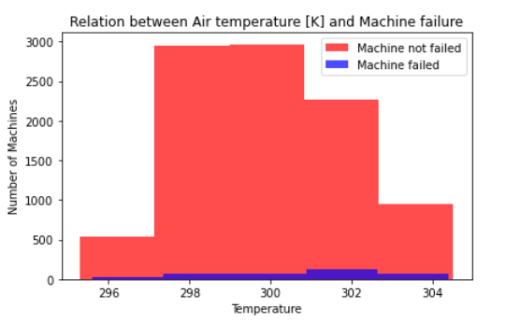
Relationship between variables and machine failure
By looking at the figure , apparently, machines failures have been occurred in all the Air temperatures.

Slide 6
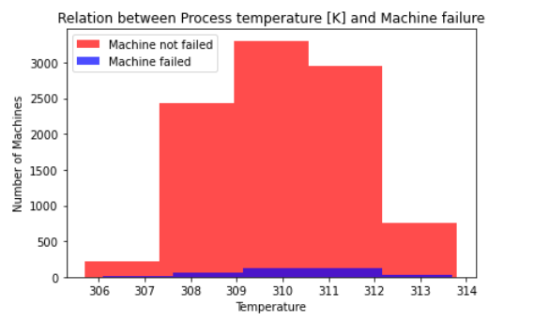
Relationship between variables and machine failure
Like relation between Air temperature and Machine failure, relation between Process temperature and Machine failure apparently doesn’t gives any direct insights.

Slide 7
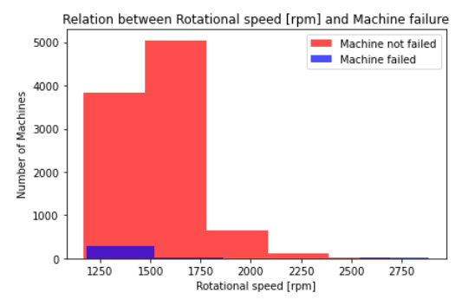
Relationship between variables and machine failure
Relation between Rotational speed [rpm] and Machine failure, we can clearly see from figure most of the machines with higher RPM have failed.

Slide 8
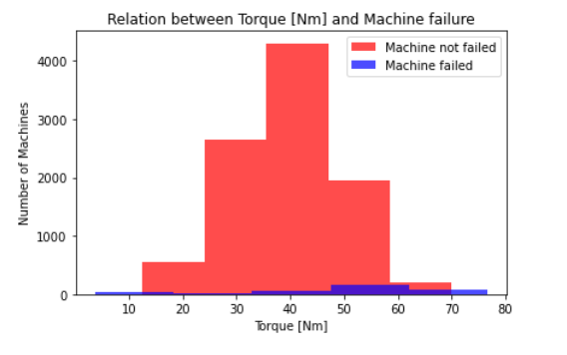
Relationship between variables and machine failure
From figure we can clearly see that there are more machine failure incidents at higher machine Torques. We can see that there are high percentage machine failures for Torque greater than 62 Nm.

Slide 9
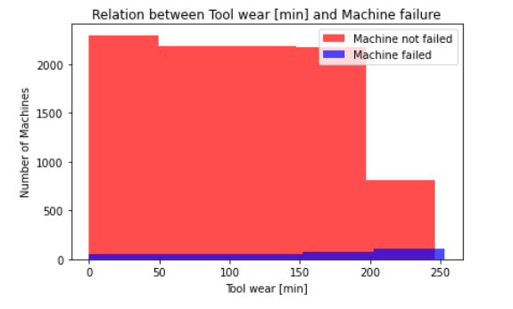
Relationship between variables and machine failure
For machines with tool wears more than 200 minutes have higher chances of break down.

Slide 10
Data preprocessing
There was not much work in processing data as there were no NAs in any of the columns. The only processing conducted is label encoding for the feature, ‘Type’ as it has the categorical values ‘L, M, H’, the encoded feature name is Types_Cat. Later, the data has been subset with the features mentioned below.
Tool wear [min]
Torque [Nm]
Rotational speed [rpm]
Air temperature [K]
Process temperature [K]
Types_Cat
The data has been split into trainset (70%) and testset (30%). By doing that we have 237 machine failure incidents in trainset and 102 machine failure incidents in testset. This check helps to have a comparison with our models’ prediction.

Slide 11
Models and interpretation

Slide 12
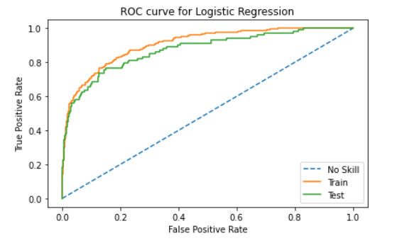
LOGISTIC REGRESSION
Logistic regression is used as our first model as it is a simple and more efficient method for binary and linear classification problems. It is a classification model, which is very easy to realize and achieves very good performance with linearly separable classes.
The model has fitted with trainset and validated with test set. The ROC cure for the train and test sets can be seen in the figure. We can see that it’s a good fit with Area Under Curve (AUC) of train equal to 81.56 % and AUC of test equal to 80.24%, which means the model has good discriminatory ability.
The threshold of 0.040175 is chosen to predict the machine failure incidents in test set. The best threshold is calculated through ROC curve by taking the geometric means of thresholds and selecting the threshold with best True Positive Rate. It is important to choose optimum threshold to predict as the default threshold i.e., 0.5 can lead in poor performance of the model. With the threshold chosen through ROC the accuracy of the trainset is 85.21% and test set is 84.67%.

Slide 13
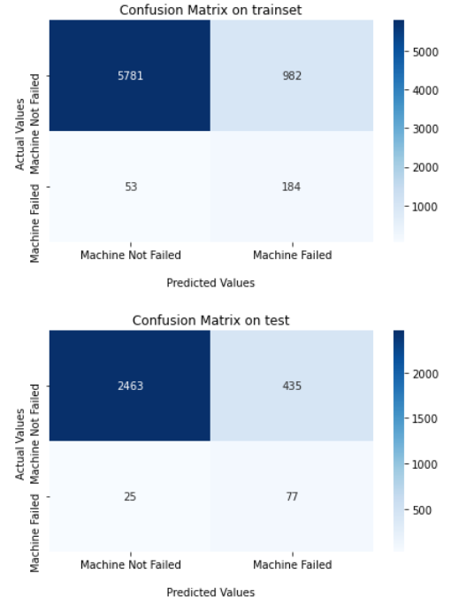
Logistic regression-confusion matrix
Figure shows the confusion matrix for train and test sets.
The model predicted 184 machine failure incidents properly in train set which is 77% of the actual machine failures in trainset.
Confusion matrix on test set says that the model predicted 77 machine failures correctly which is 75% of the actual machine failures.
The model performed well in predicting the non-failure incidents which is around 85% for both train and test.

Slide 14
Logistic regression interpretability

Slide 15
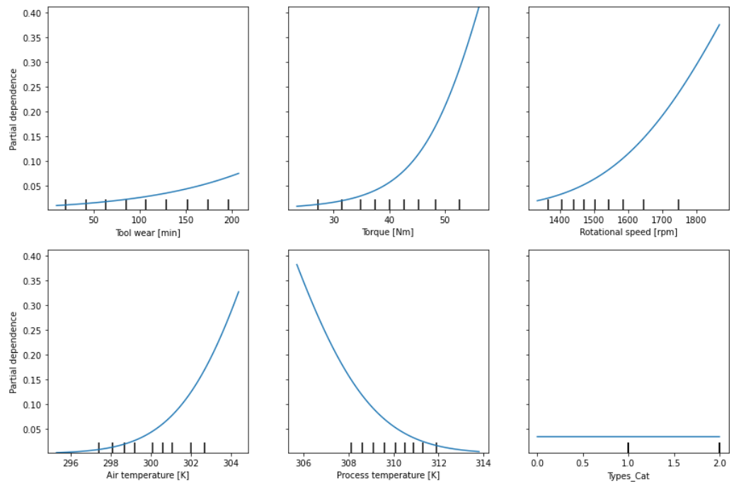
Partial dependence plots
The partial dependence plot is used because it shows the marginal effect of one or two features have on the predicted outcome of a machine learning model and show the relationship between the target variable and a feature is linear or complex
It can be seen from the plot that Torque [Nm], Rotational speed and Air temperature have more positive impact on machine failure and Process Temperature has the negative impact. Though Tool wear has some positive impact it is negligible as seen when compared to other features. The Type of machine has no impact on failure incidents.

Slide 16
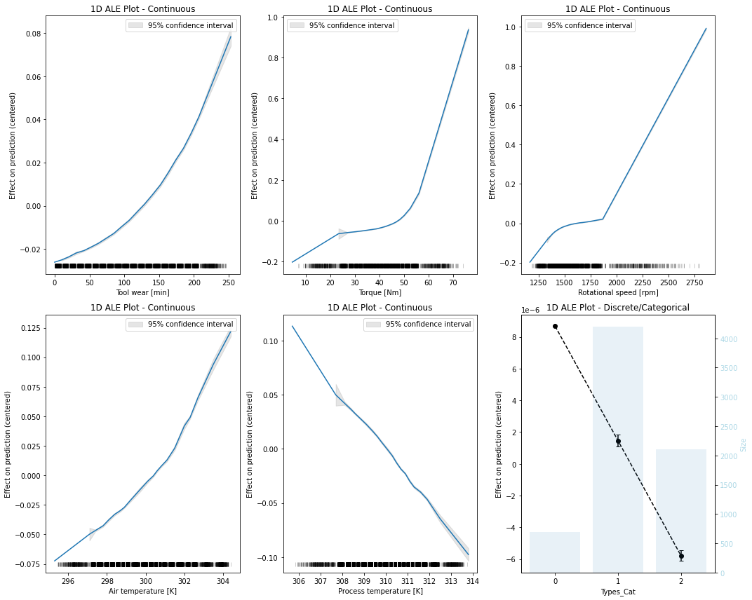
Accumulated local effect
ALE plots highlight the effects of features have on the predictions of a machine learning model by partially isolating the effects of other features. The resulting ALE explanation is centered around the mean effect of the feature, such that the main feature effect is compared relative to the average prediction of the data.
The plots say Torque [Nm] and Rotation speed [rpm] have higher impact on machine failures.

Slide 17
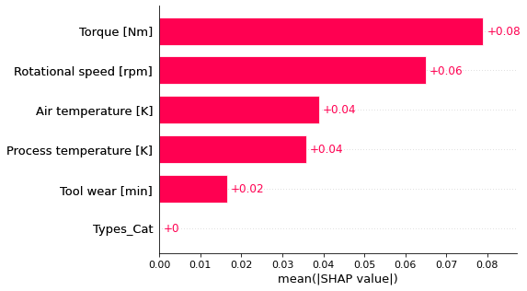
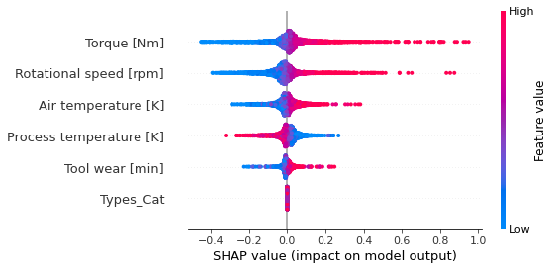
Shapley values
The Shapley value is the average expected marginal contribution of one feature after all possible combinations have been considered. Shapley value helps to determine a payoff for all the features when each feature might have contributed more or less than the others.
Figures are the global interpretation of Shapley values and the impact of features on model output for Logistic Regression. Torque has the highest impact on Machine failure followed by Rotational speed, Air and Pressure temperature.
The 2nd figure says that Torque and Rotational speed have highest positive impact on model output followed by Air temperature which means as they increase the machine failure probability increases while Process temperature has negative impact on model output which means as it decreases the failure probability increases.

Slide 18
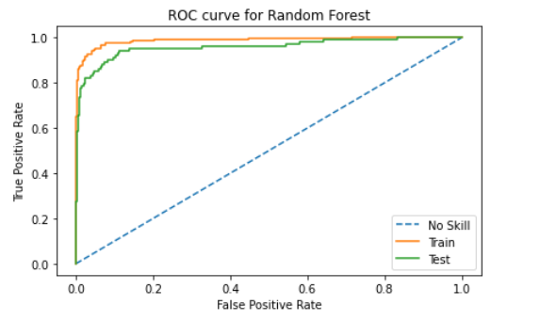
RANDOM forest
Random Forest is a machine learning algorithm which is widely used in classification and regression problems. It performs exceptionally well for classification problems.
The model has fitted with trainset with 200 estimators and maximum depth of 6 and validated with test set. The ROC cure for the train and test sets can be seen in the below figure. We can see that it’s a good fit with Area Under Curve (AUC) of train equal to 93.13 % and AUC of test equal to 90.96%, which means the model has excellent discriminatory ability.
The threshold of 0.035077 is chosen to predict the machine failure incidents in test set. The best threshold is calculated through ROC curve by taking the geometric means of thresholds and selecting the threshold with best True Positive Rate. With the threshold chosen through ROC the accuracy of the trainset is 88.69% and test set is 88.93%.

Slide 19
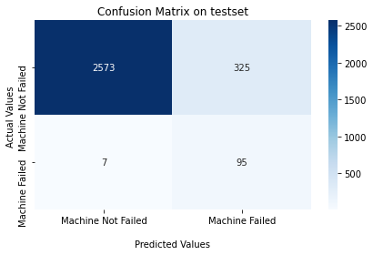
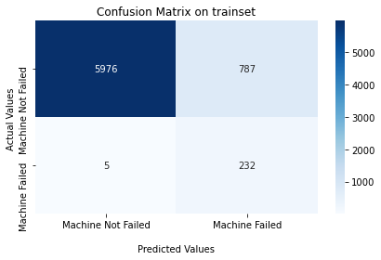
Random forest - confusion matrix
The model predicted 232 machine failure incidents properly in train set which is 97.8% of the actual machine failures in trainset.
Confusion matrix on test set says that the model predicted 95 machine failures correctly which is 93.13% of the actual machine failures.
Here the model performed exceptionally well in predicting the machine failure.

Slide 20
Random forest interpretability

Slide 21
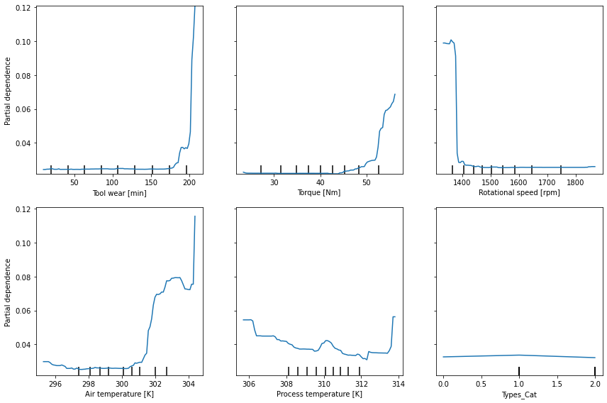
Partial dependency plot
It can be seen from the plot that Torque [Nm], Air temperature and Tool wear have more positive impact on machine failure and Rotational speed has the negative impact. The Type of machine has no impact on failure incidents and Process temperature impact can’t be predicted with plot.

Slide 22
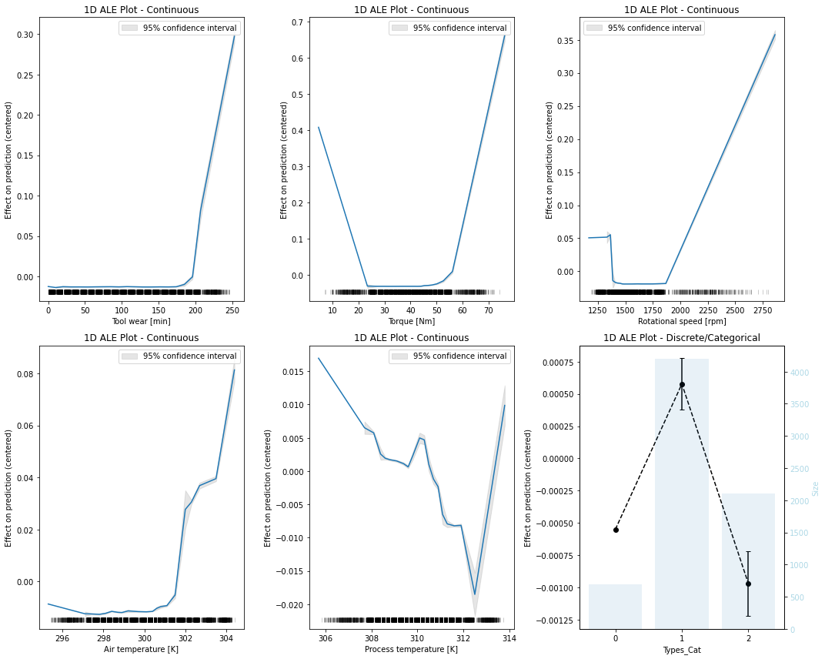
Accumulated local effect
The plots say Torque [Nm] and Rotation speed [rpm] have higher impact on machine failures. When the torque of machine is greater than 60 Nm there is a positive impact and negative impact when lesser than 22 Nm and rotational speed is above 2000 rpm.

Slide 23
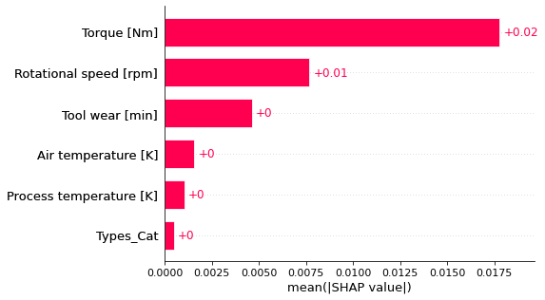
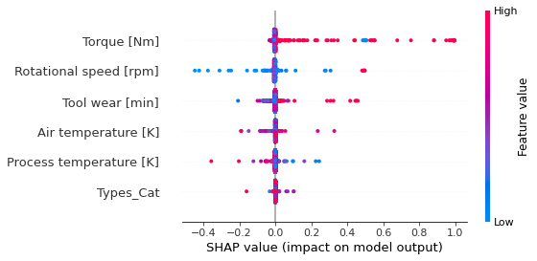
Shapley values
Figures shown are the global interpretation of Shapley values and the impact of features on model output for Random Forest. Torque has the highest impact on Machine failure followed by Rotational speed.
The 2nd figure says that Torque and Rotational speed have highest positive impact on model output which means as they increase the machine failure probability increases. While other features have very less impact on model output.

Slide 24
Conclusion
Two models have been used with same features. It is also clear from our models that Torque, and Rotational speed features have higher impact on the machine failure. Looking at the predictions of both the models we conclude that Random Forest performed better than Logistic Regression. Random Forest has better accuracy and AUC. Model evaluation was on test set with 3000 observations in which there were 102 machine failure incidents. Logistic Regression model predicted 77 incidents properly whereas Random Forest Model predicted 95 incidents properly. Therefore, it is advisable for the company to implement Random Forest model to predict the machine failure incidents.

Slide 25
Thank you

